Slide 1




EDA – SQL Project on the Lego Dataset
Dusan Dokic

Slide 2

Dataset Overview
The LEGO dataset provides comprehensive information about LEGO sets, parts, colors, and inventories, originally compiled to assist users in identifying what sets they can build with the LEGO pieces they own.
Table Name | Description | Columns | Example | Number of Rows
part_categories | Organizes LEGO parts into various categories. | id, name | (1, "Bricks") | 57
parts | Lists unique LEGO parts and their identifiers | part_num, name, part_cat_id | ("3001", "Brick 1x1", 1) | 25,993
themes | Contains themes with hierarchical parent IDs for analysis. | id, name, parent_id | (1, "Star Wars", NULL) | 614
colors | Provides a color palette for LEGO parts, including RGB values. | id, name, rgb, is_trans | (1, "Red", "FF0000", "f") | 135
sets | Lists LEGO sets, including release years and themes | set_num, name, year, theme_id, num_parts | ("75252", "Imperial Star Destroyer", 2019, 1, 4,784) | 11,673
inventories | Maps parts to their respective sets | id, version, set_num | (1, 1, "75252") | 11,681
inventory_parts | Details parts in each inventory, including quantities and spare status. | inventory_id, part_num, color_id, quantity, is_spare | (1, "3001", 1, 10, "f") | 580,251
inventory_sets | Shows the relationship between inventories and specific sets. | inventory_id, set_num, quantity | (1, "75252", 1) | 2,846

Slide 3

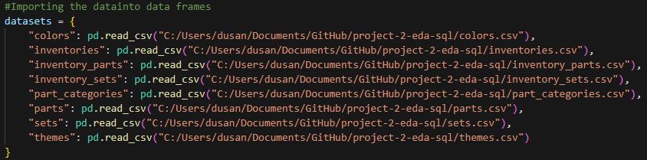
EDA
STEP 1:
Looking at the data and identifying missing Data
Created a dictionary with all the tables as dataframes
This structure allows easy access to multiple datasets while keeping them organized.
Used a for loop to iterate through each dataset in the datasets dictionary.
For each df applied .info(), .shape() etc. to get an overview over the data

Slide 4

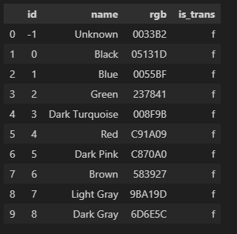
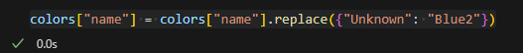
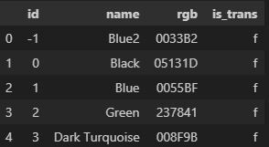
EDA
STEP 2:
Data Cleaning
Iterated Through Datasets: Used a for loop to access each dataset in the datasets dictionary.
Printed Overview Title: Displayed a title for each dataset to indicate which dataset is currently being explored.
Displayed First 10 Rows:Used df.head(10) to show the first 10 rows of each DataFrame for quick inspection of data structure and content.
Modified Colors Dataset: Replaced occurrences of "Unknown" in the name column of the colors DataFrame with "Blue2" using colors["name"].replace({"Unknown": "Blue2"}).

Slide 5
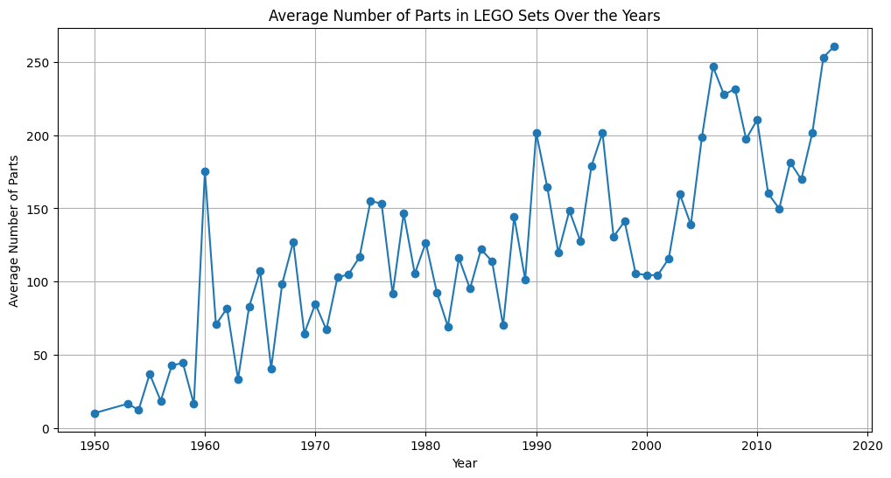

EDA
STEP 3:
Univariate Analysis
Data Inspection: Reviewed the structure of the LEGO sets dataset to understand its contents.
Frequency Analysis: Analyzed the frequency of LEGO set names to identify the most commonly produced sets.
Top Sets Identification: Focused on the top 10 sets based on production frequency for further analysis.
Trend Visualization: Created visualizations to show the production trends of the top LEGO sets over the years.

Slide 6

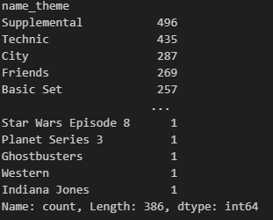
EDA
STEP 4:
Bi-Variate Analysis
Data Merging: Merged the filtered_sets DataFrame with the themes DataFrame based on the theme_id column from the sets and the id column from themes.
Theme Count Analysis: Analyzed the themes associated with the top LEGO sets by calculating the frequency of each theme using value_counts().
Top Themes Display: Printed the counts of the top themes to understand the distribution and prominence of different themes in the dataset.

Slide 7
Data Quality Issues & Fixes
1. Empty parent_id Values in themes.csv
Issue: Empty strings instead of NULLs caused load errors.
Fix: Replaced empty strings with NULL values; modified the CSV using the NULLIF function.
2. String Values in is_trans Column in colors.csv
Issue: Contained 'f' and 't' instead of 0 and 1, leading to type mismatch errors.
Fix: Replaced 'f' with 0 and 't' with 1; created a new CSV with corrected values.
3. String Values in is_spare Column in inventory_parts.csv
Issue: Used 'f' and 't' instead of numeric values (0 and 1).
Fix: Converted 'f' to 0 and 't' to 1; generated a corrected CSV for successful loading.
5. Duplicate Entries in inventory_parts.csv
Issue: Duplicate primary key entries caused load errors.
Fix: Identified and removed duplicates; created a new CSV without duplicate rows.
6. Missing part_num Values in inventory_parts.csv
Issue: Some part_num values did not exist in parts.csv, causing foreign key violations.
Fix: Cross-referenced and removed invalid part_num entries; generated a cleaned CSV.

Slide 8
SQL -Creating Database & Tables
Welcome

Slide 9
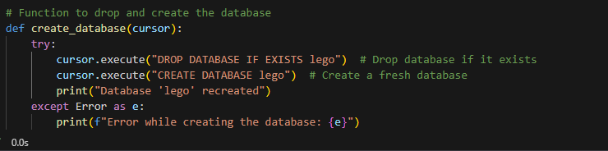
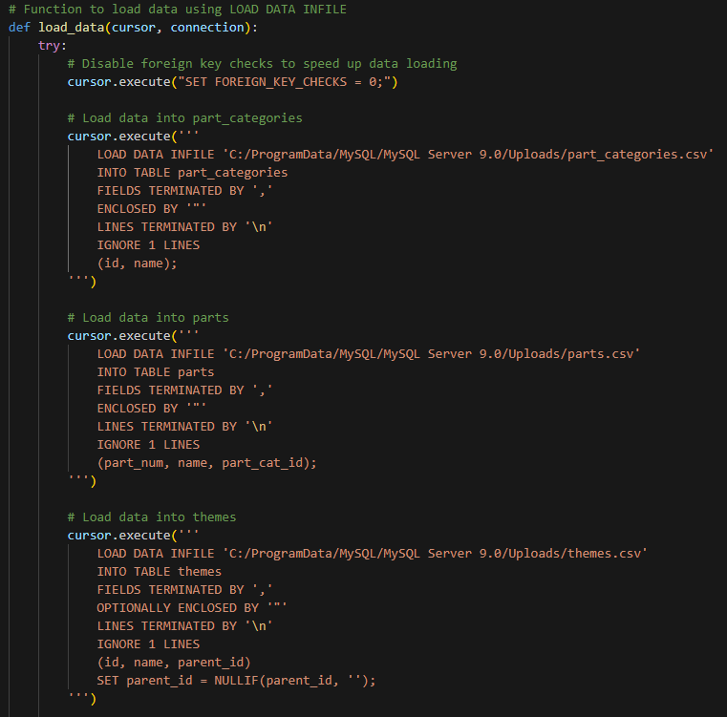
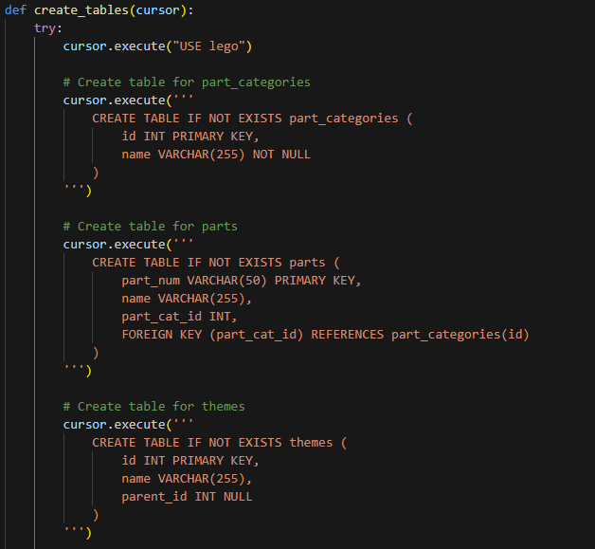
Creating the Data Base
Loading the Data
Creating the Tables

Slide 10
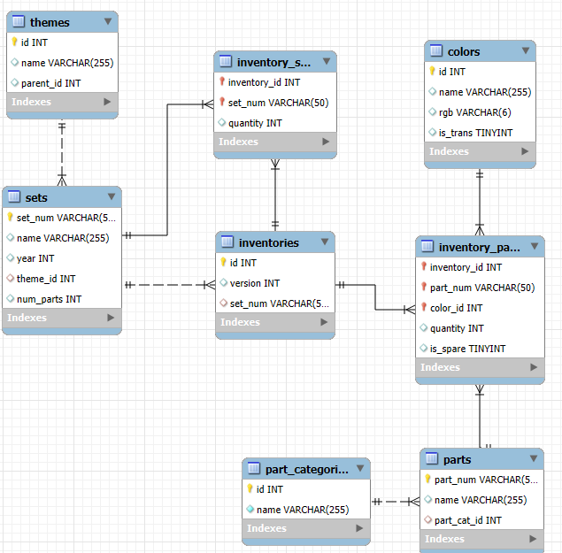
DATABASE EER

Slide 11
Business Questions
Welcome

Slide 12

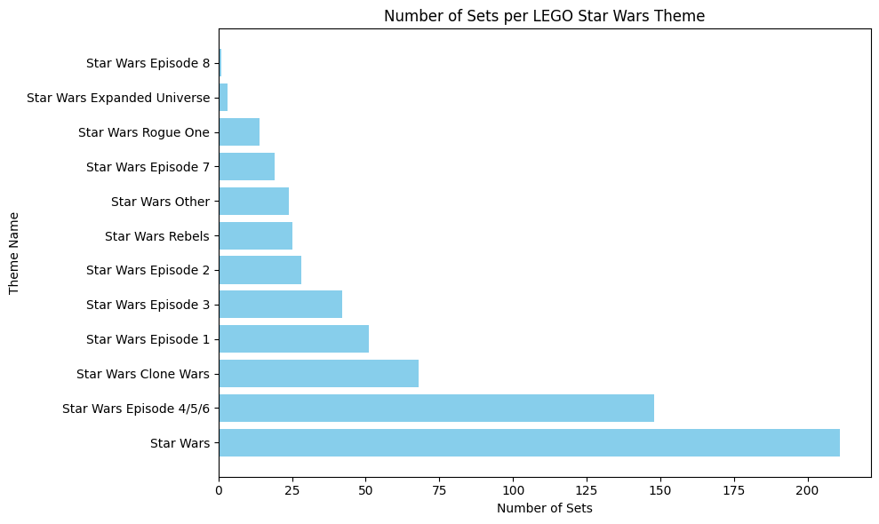
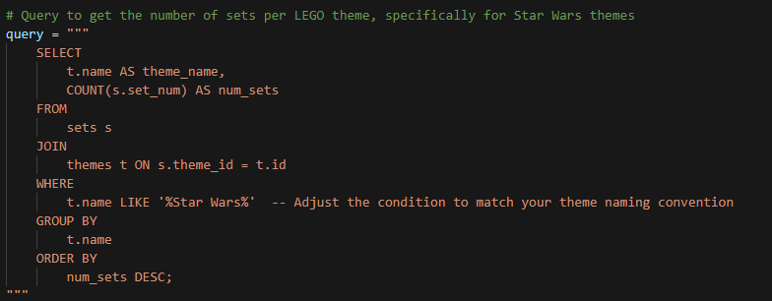

1.How many Star Wars Sets are there?
Identify the number of sets of one Theme of your choice.

Slide 13
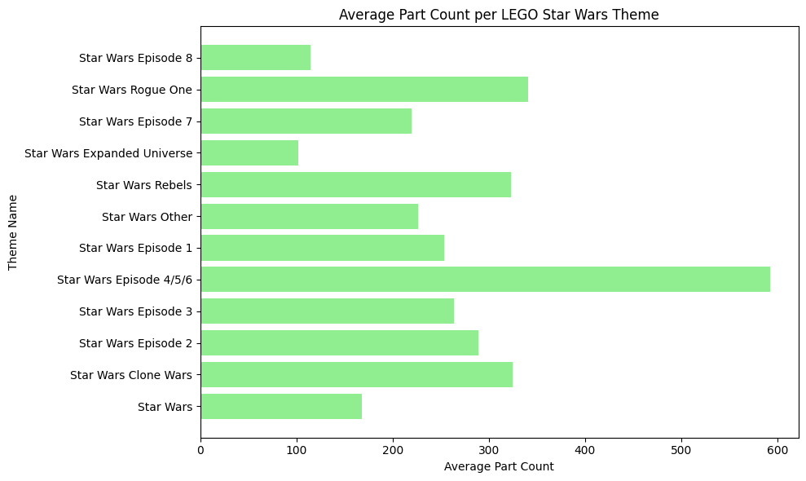
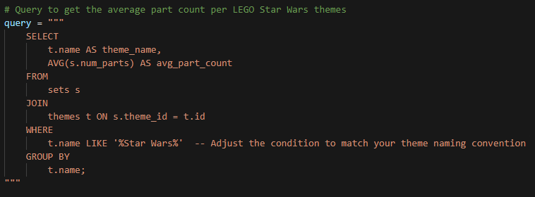
2.What is the average part count per set for each theme?
Analyze the complexity of sets within different themes by calculating the average number of parts.

Slide 14
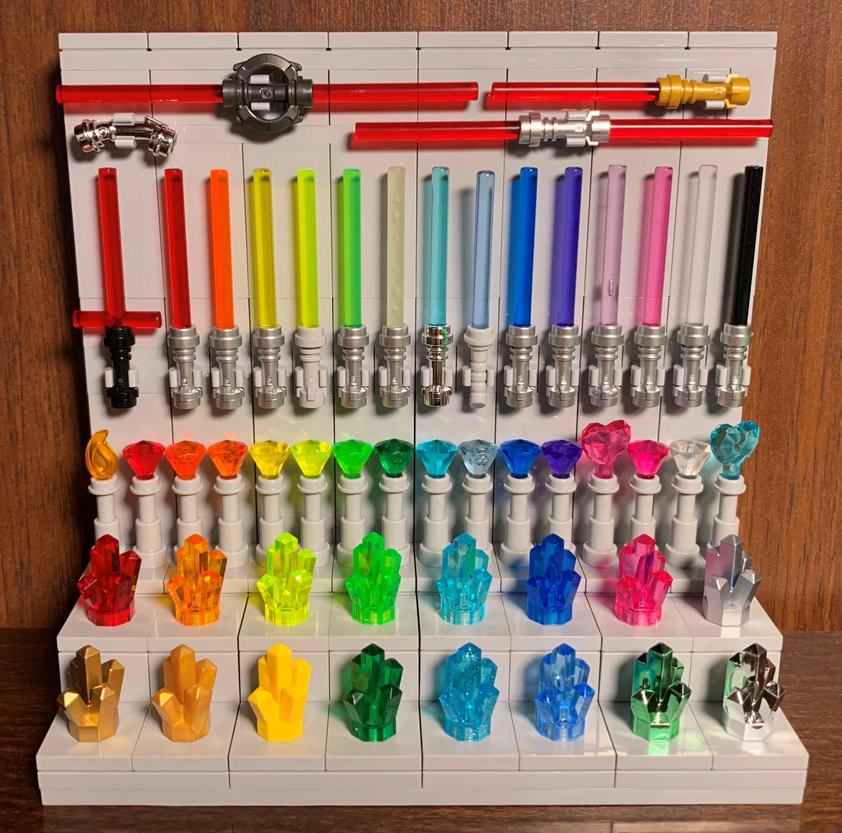
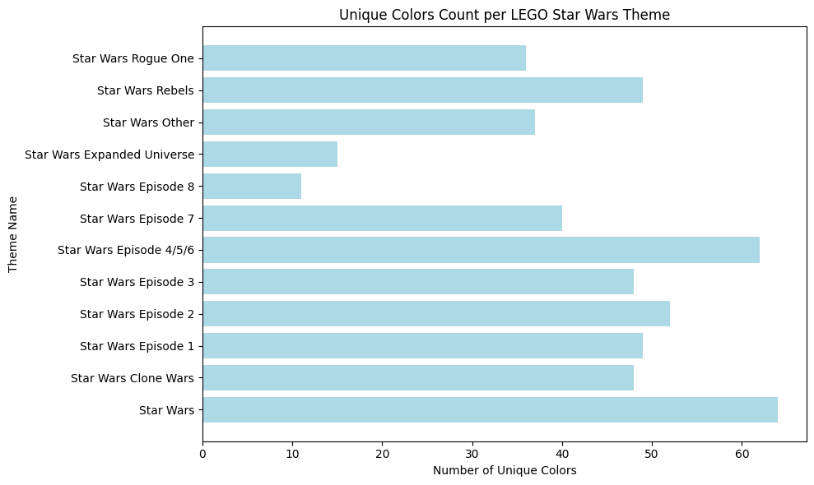
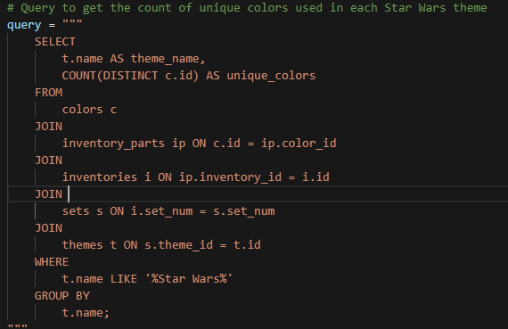
3.How many unique colors are used across all themes?
Determine the overall color diversity in LEGO sets by counting unique colors.

Slide 15
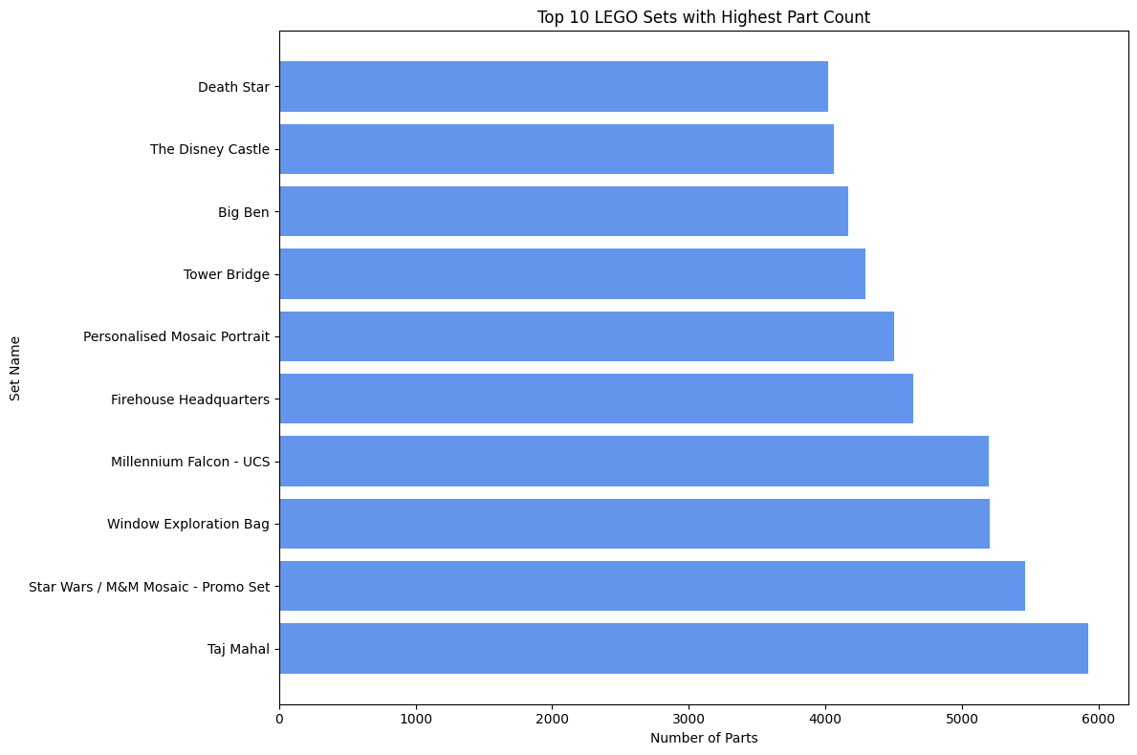
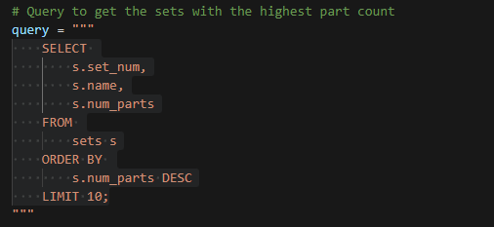
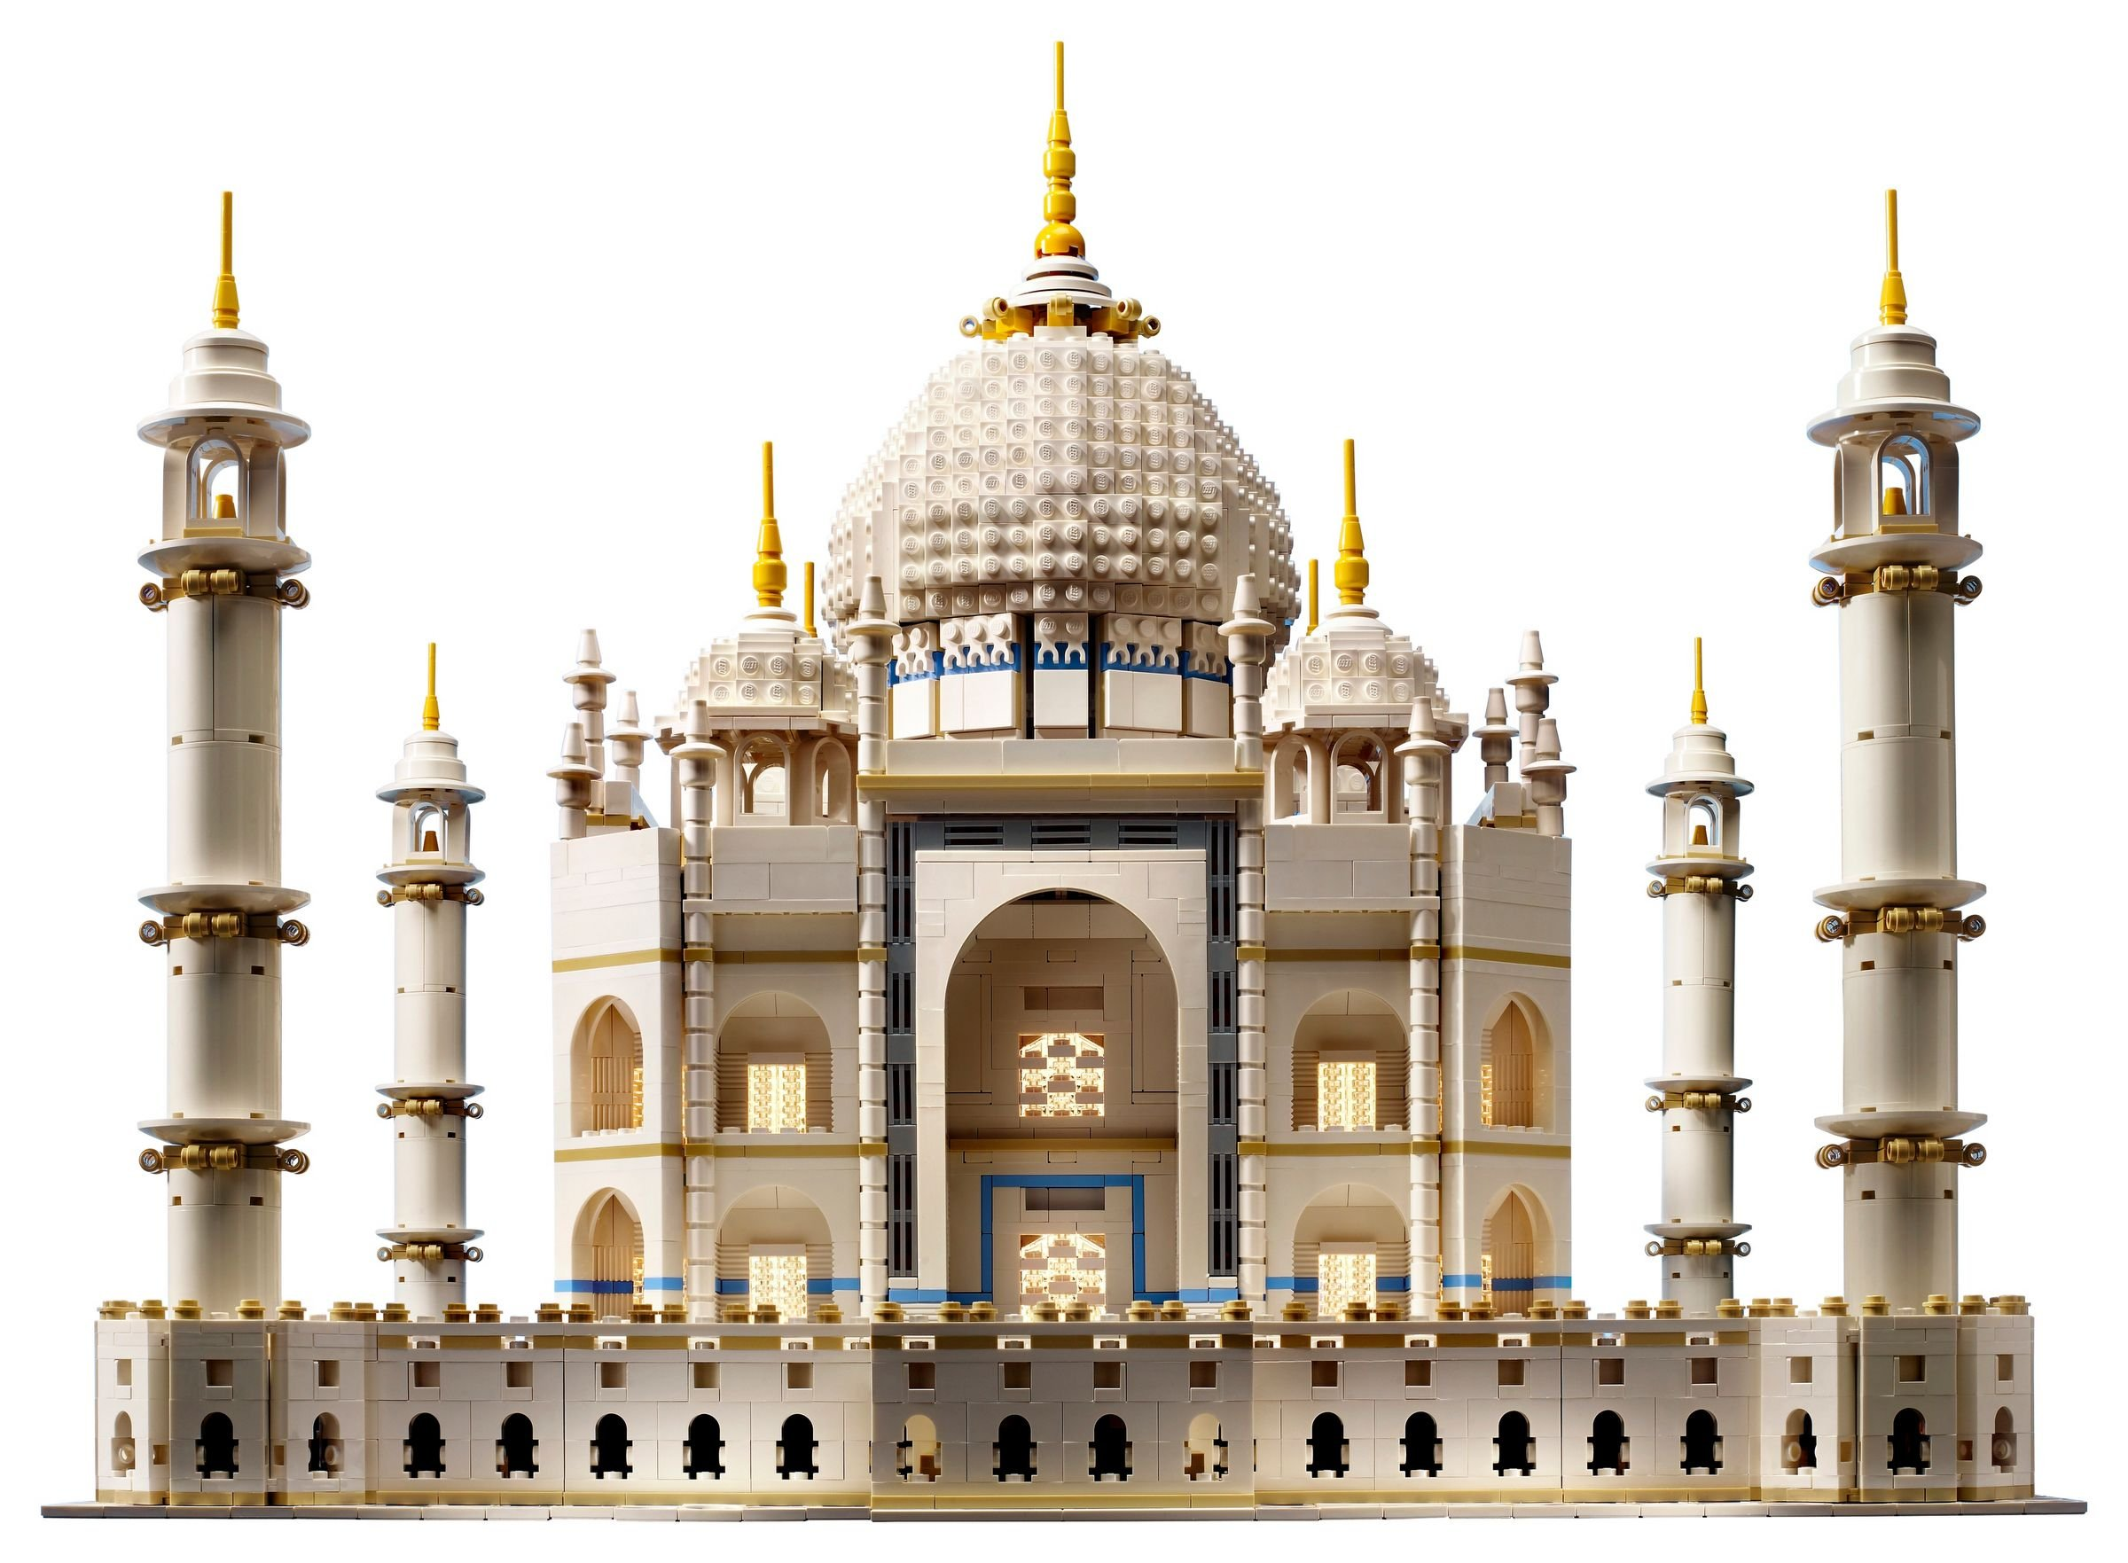
4. Which sets have the highest part count?
Identify the specific sets that are the most complex in terms of the number of parts used.

Slide 16
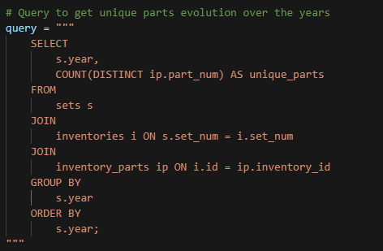
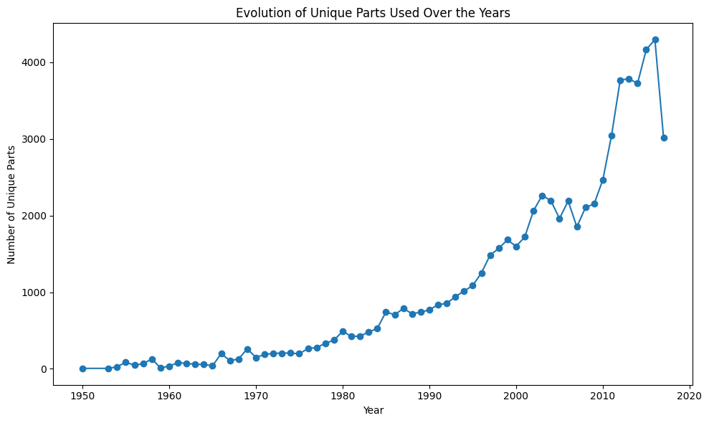
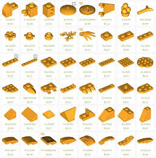
5. How has the number of unique parts used in sets evolved over the years?
Analyze trends in the use of unique parts in LEGO sets over time.

Slide 17
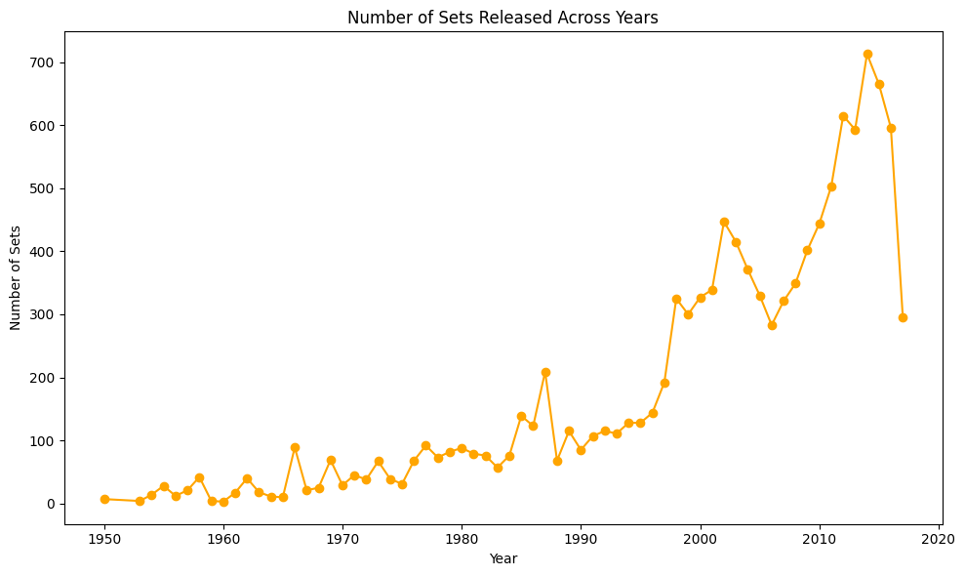
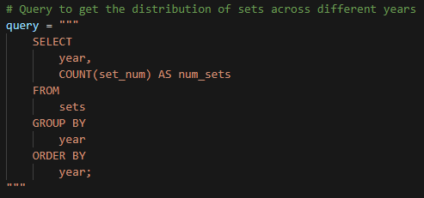
6.What is the Number of sets released across different years?
Understand how many sets were released each year, which can indicate market activity and trends.

Slide 18
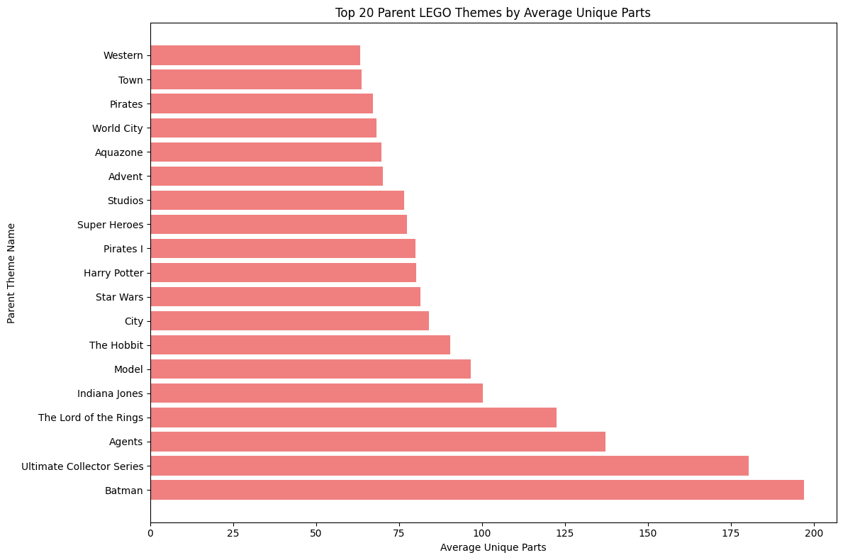
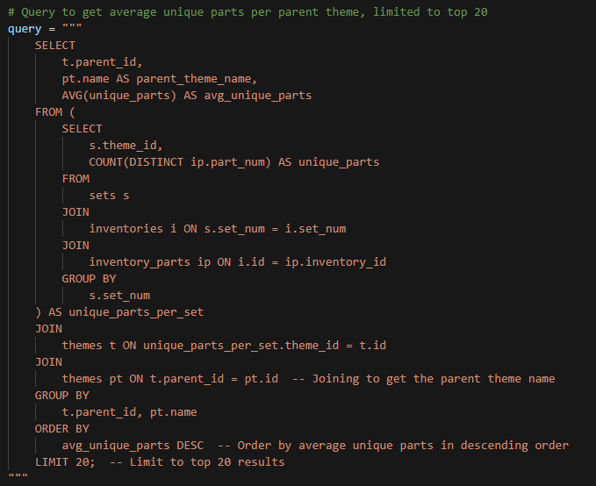

7.Which themes have the highest average number of unique parts per set?
Determine which themes are most innovative by looking at the average number of unique parts used in their sets.

Slide 19
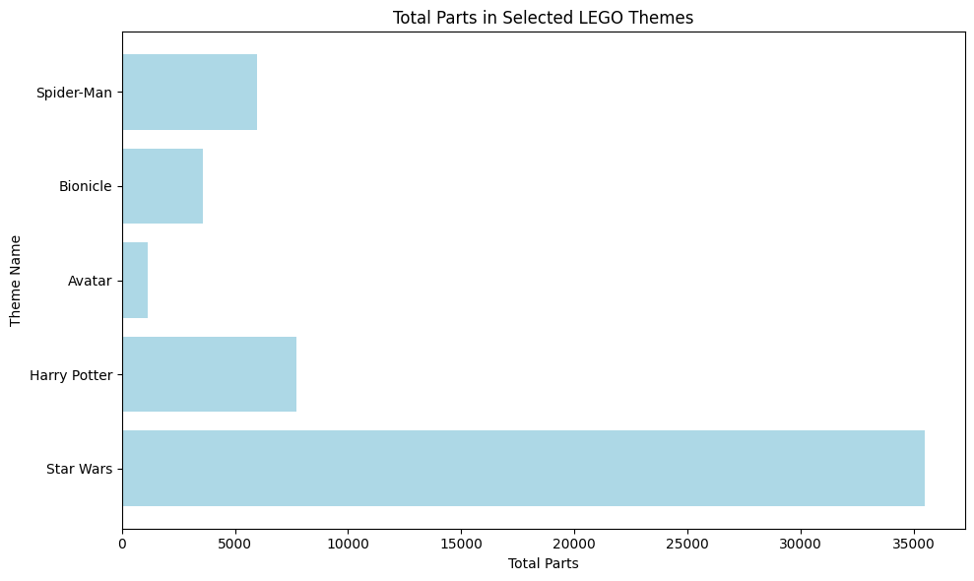
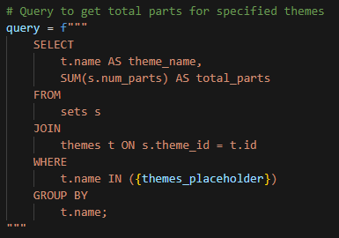
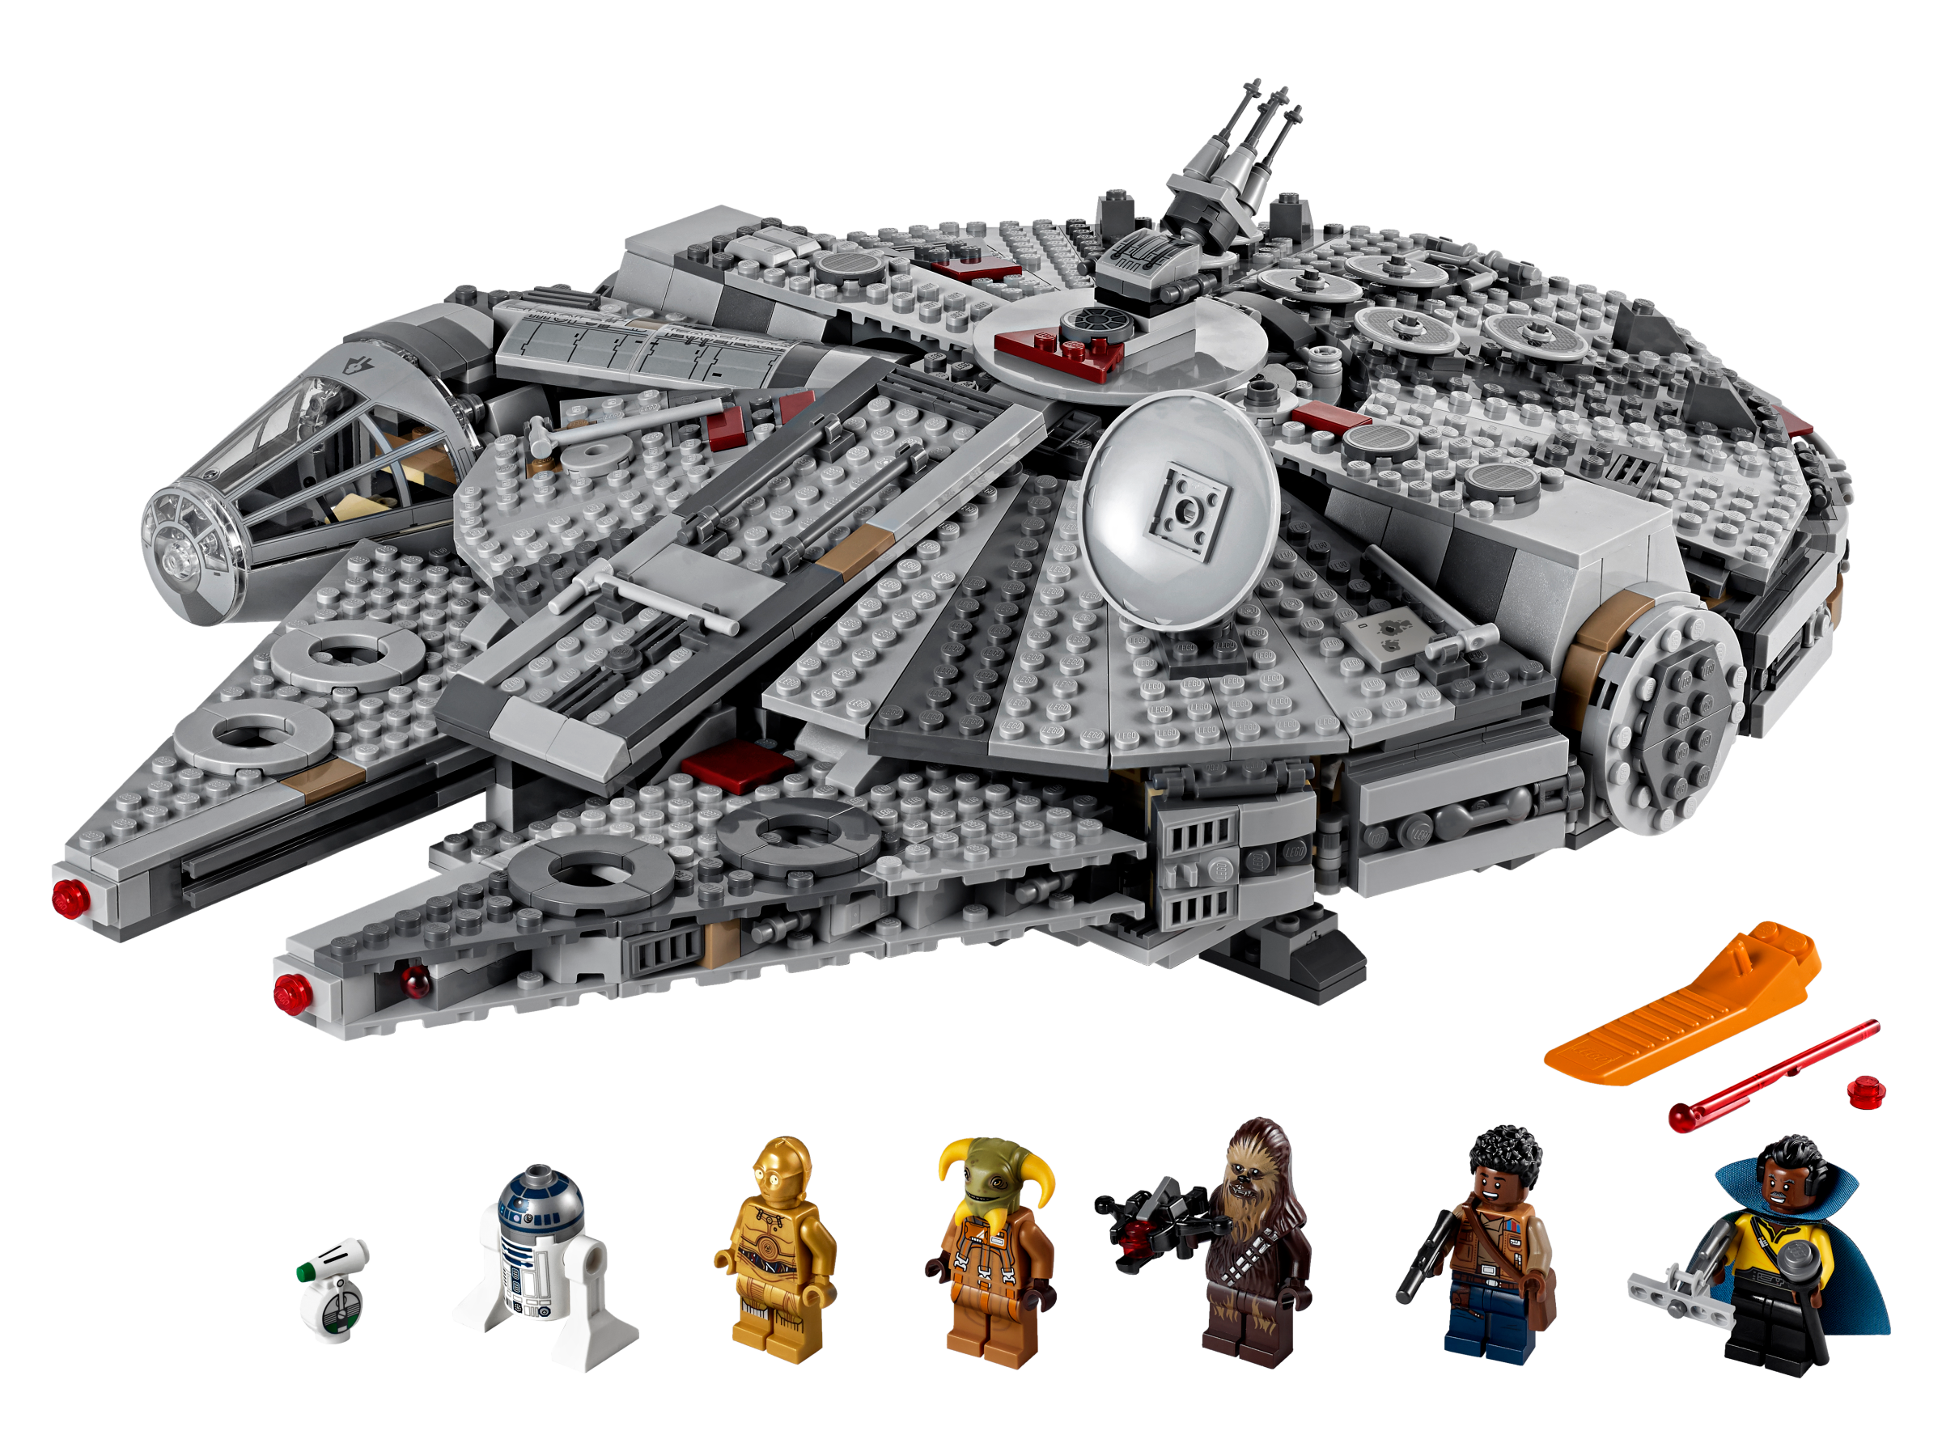
8.What is the total number of parts used in all sets of a specific theme?
Calculate the total part count for a specific theme to assess its material usage

Slide 20
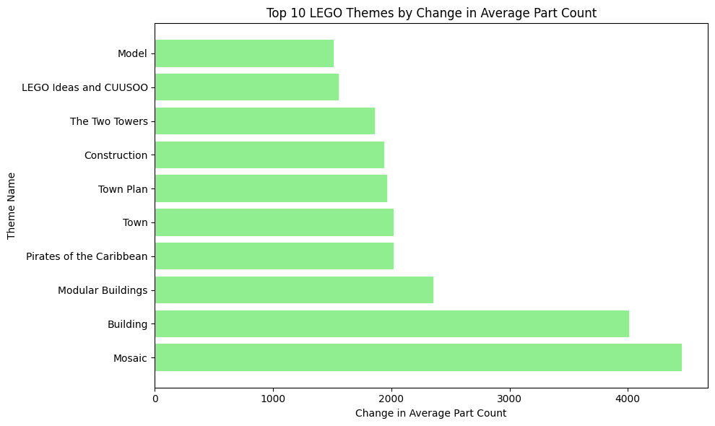
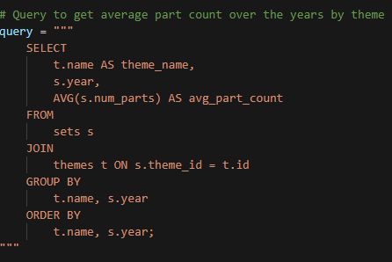

9.Which themes have experienced the most significant change in average part count over time?
Identify themes that have increased or decreased in complexity based on average part counts across years.

Slide 21
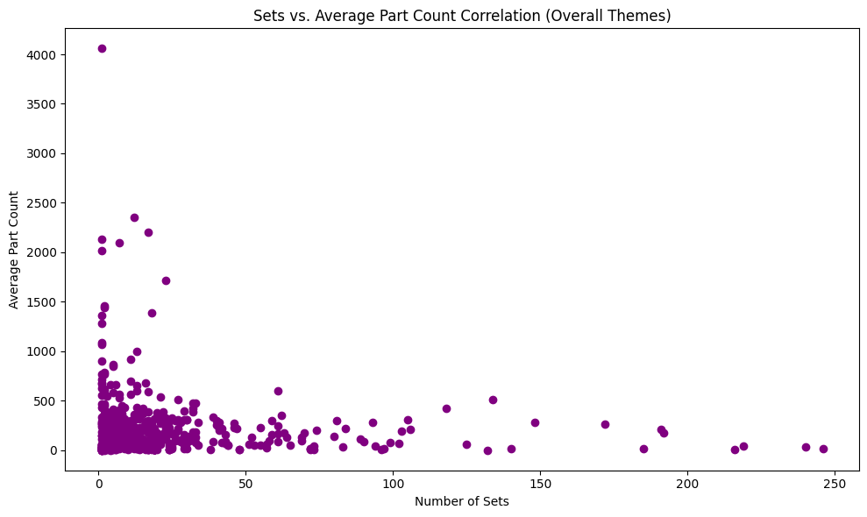
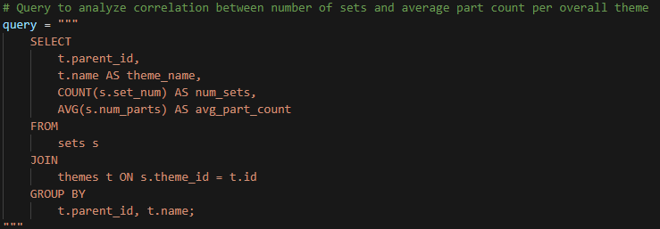

10. How do the number of sets and average part count correlate within each theme?
Analyze the relationship between the number of sets and the average part count for themes to see if more sets mean more complex designs.

Slide 22
Thank you!
Welcome

